Slide 1
HANDWRITTEN SIGNATURE RECOGNITION USING
MACHINE LEARNING

Slide 2
INDEX
Abstract
Objective of project
Problem Statement
Scope & Motivation
Introduction
Literature survey
Existing Method
Disadvantages
Proposed method
Advantages
Project Flow
Hardware and Software Requirements
Architecture
Modules
UML Diagram
Output Screenshots
Conclusion
Future Scope
References

Slide 3
ABSTRACT
In the realm of document verification, handwritten signature classification emerges as a pivotal component. This paper introduces a robust system for handwritten signature classification employing Convolutional Neural Networks (CNN) and the lightweight Mobile Net architecture, optimizing the accuracy and efficiency of the signature verification process. Signature classification, a challenging task due to the inherent variations and idiosyncrasies in individuals’ handwriting styles, demands a technique that can understand and learn these nuanced differences. The proposed model incorporates a CNN, effectively extracting hierarchical features from the signature images, while the Mobile Net architecture ensures the model's lightweight nature and adaptability to various devices, including those with limited computational resources.

Slide 4
ABSTRACT
Furthermore, our approach leverages data augmentation and transfer learning techniques to enhance the model's generalization capabilities and performance on unseen data. Experimental results demonstrate that the proposed signature classification system achieves commendable accuracy and reduced latency, making it a suitable candidate for real-time applications in secure document verification and identity authentication arenas.
Keywords: Deep Learning, Convolutional Neural Networks (CNN), Mobile net, Image Processing.

Slide 5
OBJECTIVE OF PROJECT
This study aims to develop a robust handwritten signature classification system by ingeniously integrating Convolutional Neural Networks (CNN) with the Mobile Net architecture. The objective is to leverage the powerful feature extraction capabilities of CNNs, and the lightweight and efficient characteristics of Mobile Net, to create a model that is both accurate and resource-efficient. Furthermore, the study seeks to employ transfer learning and data augmentation techniques to improve the model's performance, making it adaptable and effective in handling the diverse and challenging nature of handwritten signatures.

Slide 6
PROBLEM STATEMENT
Despite their widespread acceptance, handwritten signatures exhibit significant variations, even from the same individual, due to changes in mood, health, and age, making accurate classification arduous. Existing classification systems either lack in accuracy or require extensive computational resources, making them impractical for real-time applications and deployment on devices with limited computational capacity. There is a pressing need for a system that not only provides accurate classification results but is also efficient and adaptable to various technological infrastructures.

Slide 7
SCOPE AND MOTIVATION
Motivation:- The digital era has witnessed an explosive increase in the necessity for secure and efficient methods for document verification and identity authentication. Handwritten signatures, universally accepted as a form of personal verification, are often subjected to forgery and misclassification, thus necessitating the development of advanced classification mechanisms. Employing deep learning, specifically CNN and Mobile Net, for handwritten signature classification, offers a promising approach to address these challenges due to their capability in feature extraction and lightweight deployment on various platforms.

Slide 8
SCOPE AND MOTIVATION
Scope:- The scope of this research extends to the design, development, and evaluation of a handwritten signature classification system based on CNN and MobileNet architecture. The study will explore various data augmentation techniques to enhance the training dataset and utilize transfer learning to improve the model's generalization on unseen data. The research will be validated using a diverse dataset of handwritten signatures, considering different writing styles, ages, and cultural backgrounds to ensure the developed system's effectiveness and applicability in real-world, diverse settings. The performance of the proposed system will be benchmarked against existing classification techniques in terms of accuracy, efficiency, and deployment feasibility on devices with varying computational capacities.

Slide 9
INTRODUCTION
Traditional classification mechanisms have often fallen short of expectations, primarily due to their inability to accommodate the wide variations in handwritten signatures. The limitations of these traditional approaches, which range from manual verification to simple pattern recognition techniques, underscore the need for advanced, automated solutions leveraging the power of deep learning. Convolutional Neural Networks (CNNs), a class of deep learning algorithms, have demonstrated remarkable success in image and pattern recognition tasks due to their ability to automatically learn hierarchical features from input data.

Slide 10
INTRODUCTION
However, the complexity and computational requirements of typical deep learning models hinder their effectiveness and practicality in real-time applications, especially on devices with constrained computational resources. This constraint necessitates the exploration of lightweight yet powerful deep learning architectures. Enter MobileNet, a streamlined and efficient deep learning architecture designed for mobile and edge devices. By combining the strength of CNNs and the efficiency of MobileNet, there's potential for a signature classification system that is not only accurate but also agile and deployable on a wide range of devices.

Slide 11
LITERATURE SURVEY
S.NO | YEAR | AUTHORS | TITLE | OUT COMES
1 | 2017 | Hafemann, L. G., Sabourin, R., & Oliveira | Learning features for offline handwritten signature verification using deep convolutional neural networks | This paper discusses the usage of deep convolutional neural networks (CNN) for extracting features from offline handwritten signatures. It also presents a novel method for signature verification.
2 | 2016 | Zhang, B., Srihari, | Analysis of Handwriting Individuality Using Word Features. Proceedings of Seventh International Conference on Document Analysis and Recognition | this provides a fundamental understanding of handwriting individuality using word features, which can be beneficial in the context of signature classification and verification.

Slide 12
LITERATURE SURVEY
S.NO | YEAR | AUTHORS | TITLE | OUT COMES
3 | 2013 | Rivard, D., Granger, E., Sabourin, | Multi-feature extraction and selection in writer-independent offline signature verification | This article discusses multi-feature extraction and selection strategies for improving the performance of writer-independent offline signature verification systems.
4 | 2018 | Pal, S., Alireza, A., Pal, U., Blumenstein | Handwritten signature verification using split-and-merge deep belief network | The paper introduces a deep learning approach based on a split-and-merge strategy for signature verification. They employed a Deep Belief Network (DBN) to achieve this.

Slide 13
LITERATURE SURVEY
S.NO | YEAR | AUTHORS | TITLE | OUT COMES
3 | ICACITE paper, | Shivam Aggarwal, Ashok Kumar Sahoo, Chetan Bansal, Pradeepta Kumar Sarangi | Image Classification using Deep Learning: A Comparative Study of VGG-16, InceptionV3 and EfficientNet B7 Models | Image classification is the process of identification and classification of an input image or visual from a predetermined set of labeled images. This work comes under computer vision and machine learning.
4 | EEBDA | Youyou Guan, Yuxuan Han, Siqi Liu | Deep Learning Approaches for Image Classification Techniques | Neural network is a popular and significant research direction in machine learning, which is widely used in classification. regression, pattern recognition and other fields. Based on the current direction of academic research, the application of neural network in image classification has great research value

Slide 14
LITERATURE SURVEY
It is facilitated to access the performance and information of attendance of a particular Student in a particular semester of study. The information is sorted by the teachers, instructors and advisors, as provided by the student for a particular day throughout a complete semester.
This system will also enable the evaluation of student regular presence in various lectures which will determine the eligibility of the student to sit for a semester examination.
This user can receive alert / message from his teachers related to his attendance performance. It is obvious that Students with poor Attendance Management System attendance will see their attendance in a Red warning table that can make the student to be careful not to miss classes anymore.

Slide 15
EXISTING SYSTEM
The AlexNet algorithm, a popular convolutional neural network (CNN), has been previously utilized for handwritten signature classification, serving as an established baseline in the domain. Introduced in 2012, AlexNet significantly impacted the field of deep learning, particularly in image classification tasks, due to its depth, structure, and training methodology.

Slide 16
DISADVANTAGES
High Computational Requirements:
AlexNet, while pioneering, is a deep and complex model that demands substantial computational power and memory. This requirement often makes it unsuitable for deployment on devices with limited resources, hindering its application in real-time, on-the-edge signature verification tasks.
Prone to Overfitting:
When trained on smaller datasets, which is often the case with specialized tasks like signature verification, AlexNet is prone to overfitting. Overfitting results in the model performing exceptionally well on the training data but failing to generalize effectively to unseen data.

Slide 17
DISADVANTAGES
Large Model Size:
The AlexNet model is considerably large, often leading to inefficiencies in terms of memory usage and computational power, which is a significant concern in constrained environments or in applications where quick response time is critical.
Dependence on Data Quality:
AlexNet’s performance is heavily reliant on the quality and amount of data it is trained on. Achieving high accuracy requires large and well-curated datasets, which might not always be available or feasible for specific applications or user groups.

Slide 18
PROPOSED METHOD
The proposed system for handwritten signature classification synergistically combines Convolutional Neural Networks (CNN) and the MobileNet architecture to offer an efficient and accurate solution. In this method, signature images undergo preprocessing, resizing, normalization, and augmentation to foster a diverse dataset. The CNN layer effectively learns hierarchical features from signatures, while the lightweight MobileNet, enhanced with transfer learning from large datasets like ImageNet, handles the classification task. This fusion not only ensures computational efficiency, making it deployable on resource-constrained devices, but also maintains high accuracy and robust generalization across varied signature data. With rapid inference capabilities and scalability, this system is well-suited for real-time applications and large-scale deployment in handwritten signature classification tasks, addressing the limitations found in existing models like AlexNet.

Slide 19
ADVANTAGES
Enhanced Computational Efficiency:
MobileNet’s lightweight architecture demands fewer computational resources, facilitating efficient training and real-time inference, even on devices with limited computational power such as smartphones and tablets.
Improved Accuracy:
The combination of CNN for meticulous feature extraction and MobileNet for precise classification results in high accuracy in discerning authentic signatures from forged ones, providing a reliable solution for signature verification tasks.

Slide 20
ADVANTAGES
Robust Generalization:
Employing data augmentation techniques and transfer learning, the proposed system showcases robust generalization capabilities. It performs admirably across a diverse set of signatures, effectively handling variations in handwriting styles and qualities.
Quick Inference Time:
The streamlined architecture of the proposed model enables fast prediction times, making it ideal for applications requiring instantaneous signature verification, such as point-of-sale systems and digital document signing platforms.

Slide 21
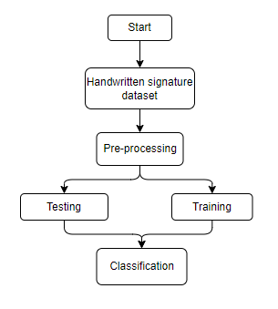
PROJECT FLLOW
Figure: work Flow of Proposed system

Slide 22
HARDWARE & SOFTWARE REQUIREMENTS
SOFTWARE REQUIREMENS
Operating System : Windows 7/8/10
Server side Script : HTML, CSS, Bootstrap & JS
Programming Language : Python
Libraries : Flask, Pandas, Mysql.connector, Os, Smtplib, Numpy
IDE/Workbench : PyCharm

Slide 23
HARDWARE & SOFTWARE REQUIREMENTS
SOFTWARE REQUIREMENS
Technology : Python 3.6+
Server Deployment : Xampp Server
Database : MySQL

Slide 24
HARDWARE & SOFTWARE REQUIREMENTS
HARDWARE REQUIREMENTS
Processor - I3/Intel Processor
RAM - 8GB (min)
Hard Disk - 128 GB
Key Board - Standard Windows Keyboard
Mouse - Two or Three Button Mouse
Monitor - Any

Slide 25
FUNCTIONAL AND NON-FUNCTIONAL REQUIREMENTS
Requirement’s analysis is very critical process that enables the success of a system or software project to be assessed. Requirements are generally split into two types: Functional and non-functional requirements.
Functional Requirements: These are the requirements that the end user specifically demands as basic facilities that the system should offer. All these functionalities need to be necessarily incorporated into the system as a part of the contract. These are represented or stated in the form of input to be given to the system, the operation performed and the output expected. They are basically the requirements stated by the user which one can see directly in the final product, unlike the non-functional requirements.

Slide 26
FUNCTIONAL AND NON-FUNCTIONAL REQUIREMENTS
Examples of functional requirements:
Authentication of user whenever he/she logs into the system
System shutdown in case of a cyber-attack
A verification email is sent to user whenever he/she register for the first time on some software system.
Non-functional requirements: These are basically the quality constraints that the system must satisfy according to the project contract. The priority or extent to which these factors are implemented varies from one project to other. They are also called non-behavioral requirements.

Slide 27
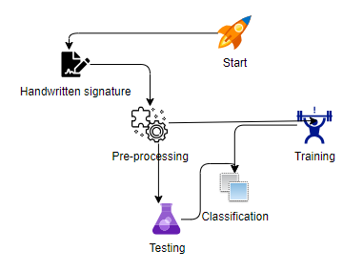
ARCHITECTURE

Slide 28
MODULES
User: Registers in the application by giving the details asked in the form
Login: Logs in into the page by providing the credentials user registered with.
Upload: Uploads the data into the model
System: Preprocess the dataset
System passes the data into model and Gives the result

Slide 29
UML DIAGRAMS
Use Case Diagram:
A use case diagram in the Unified Modeling Language (UML) is a type of behavioral diagram defined by and created from a Use-case analysis. Its purpose is to present a graphical overview of the functionality provided by a system in terms of actors, their goals (represented as use cases), and any dependencies between those use cases. The main purpose of a use case diagram is to show what system functions are performed for which actor. Roles of the actors in the system can be depicted.

Slide 30
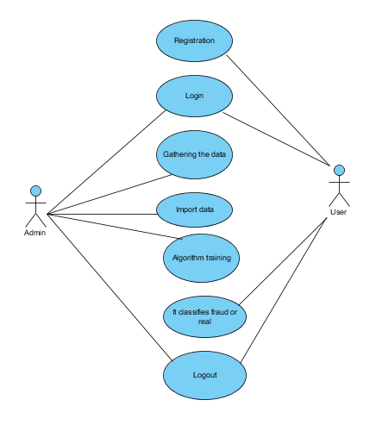
UML DIAGRAMS
Figure: Use Case Diagram

Slide 31
UML DIAGRAMS
Class Diagram:
In software engineering, a class diagram in the Unified Modelling Language (UML) is a type of static structure diagram that describes the structure of a system by showing the system's classes, their attributes, operations (or methods), and the relationships among the classes. It explains which class contains information.

Slide 32
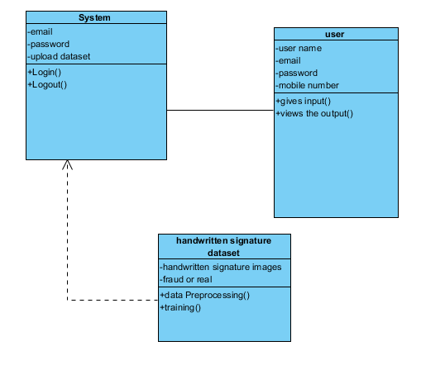
UML DIAGRAMS
Figure: Class diagram

Slide 33
UML DIAGRAMS
Sequence Diagram:
A sequence diagram in Unified Modelling Language (UML) is a kind of interaction diagram that shows how processes operate with one another and in what order. It is a construct of a Message Sequence Chart. Sequence diagrams are sometimes called event diagrams, event scenarios, and timing diagrams.

Slide 34
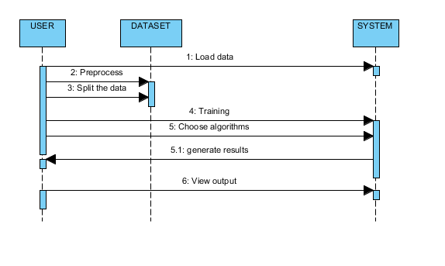
UML DIAGRAMS
Figure: Sequence diagram

Slide 35
UML DIAGRAMS
Collaboration Diagram:
In collaboration diagram the method call sequence is indicated by some numbering technique as shown below. The number indicates how the methods are called one after another. We have taken the same order management system to describe the collaboration diagram. The method calls are similar to that of a sequence diagram. But the difference is that the sequence diagram does not describe the object organization whereas the collaboration diagram shows the object organization.

Slide 36
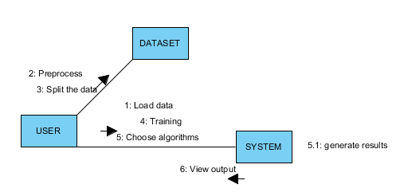
UML DIAGRAMS
Figure: Collaboration diagram

Slide 37
UML DIAGRAMS
Deployment Diagram
Deployment diagram represents the deployment view of a system. It is related to the component diagram. Because the components are deployed using the deployment diagrams. A deployment diagram consists of nodes. Nodes are nothing but physical hardware’s used to deploy the application.

Slide 38
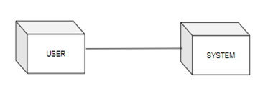
UML DIAGRAMS
Figure: Deployment diagram

Slide 39
UML DIAGRAMS
Activity Diagram:
Activity diagrams are graphical representations of workflows of stepwise activities and actions with support for choice, iteration and concurrency. In the Unified Modelling Language, activity diagrams can be used to describe the business and operational step-by-step workflows of components in a system. An activity diagram shows the overall flow of control.

Slide 40
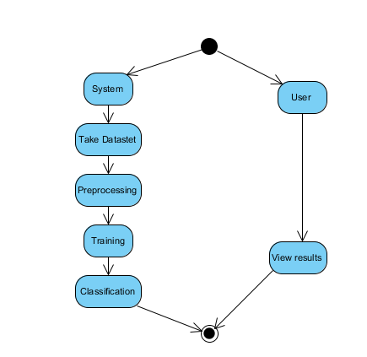
UML DIAGRAMS
Figure: Activity diagram

Slide 41
UML DIAGRAMS
Component Diagram:
A component diagram, also known as a UML component diagram, describes the organization and wiring of the physical components in a system. Component diagrams are often drawn to help model implementation details and double-check that every aspect of the system's required functions is covered by planned development.

Slide 42
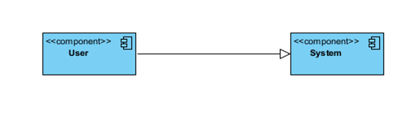
UML DIAGRAMS
Figure: Component diagram

Slide 43
UML DIAGRAMS
ER Diagram:
An Entity–relationship model (ER model) describes the structure of a database with the help of a diagram, which is known as Entity Relationship Diagram (ER Diagram). An ER model is a design or blueprint of a database that can later be implemented as a database. The main components of E-R model are: entity set and relationship set.
An ER diagram shows the relationship among entity sets. An entity set is a group of similar entities and these entities can have attributes. In terms of DBMS, an entity is a table or attribute of a table in database, so by showing relationship among tables and their attributes, ER diagram shows the complete logical structure of a database. Let’s have a look at a simple ER diagram to understand this concept.

Slide 44
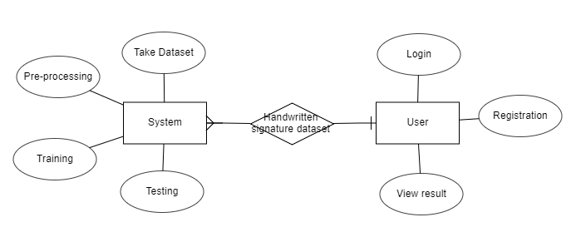
UML DIAGRAMS
Figure: ER diagram

Slide 45
UML DIAGRAMS
DFD Diagram:
A Data Flow Diagram (DFD) is a traditional way to visualize the information flows within a system. A neat and clear DFD can depict a good amount of the system requirements graphically. It can be manual, automated, or a combination of both. It shows how information enters and leaves the system, what changes the information and where information is stored. The purpose of a DFD is to show the scope and boundaries of a system as a whole. It may be used as a communications tool between a systems analyst and any person who plays a part in the system that acts as the starting point for redesigning a system.

Slide 46
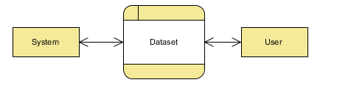
UML DIAGRAMS
Figure: Context Level diagram

Slide 47
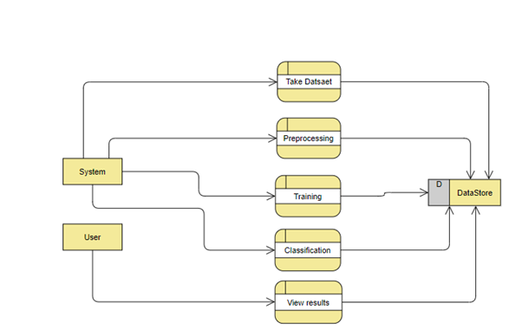
UML DIAGRAMS
FigureLevel-1 diagram

Slide 48
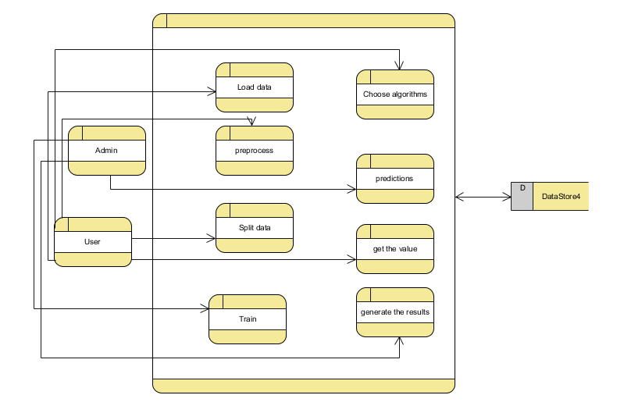
UML DIAGRAMS
Figure:Level-2 diagram

Slide 49

OUTPUT SCREENSHOTS
Home page

Slide 50
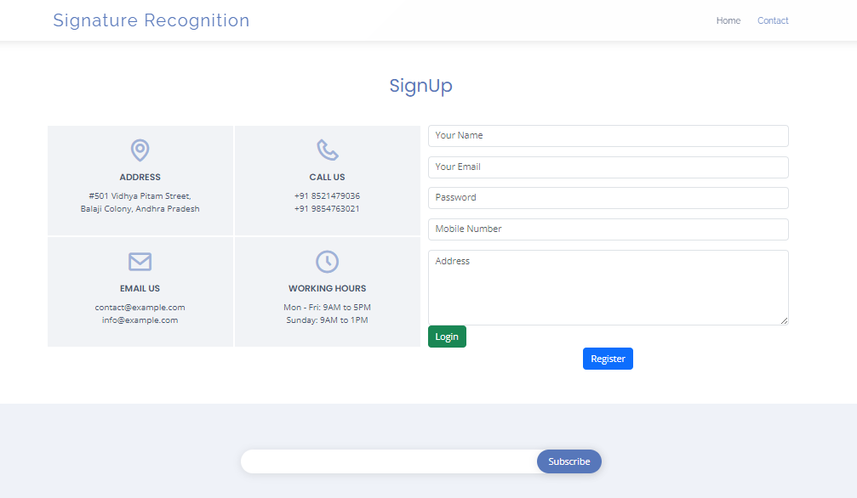
Register page

Slide 51

Login page

Slide 52
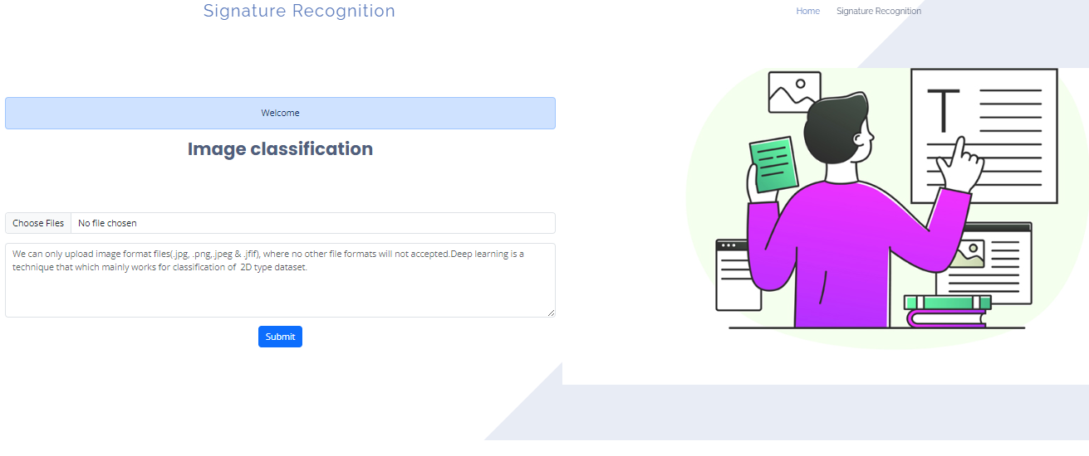
Upload page

Slide 53
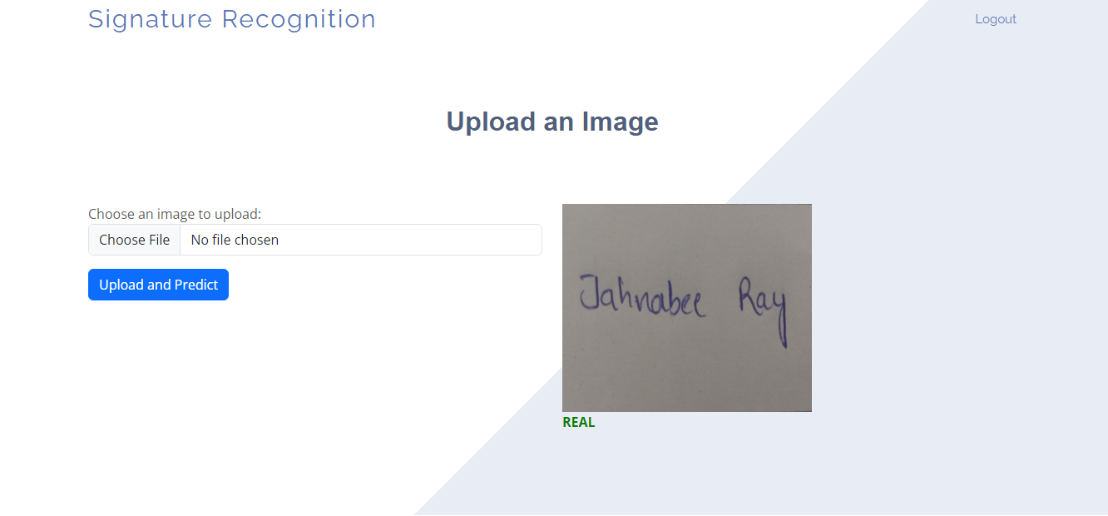
Output page

Slide 54
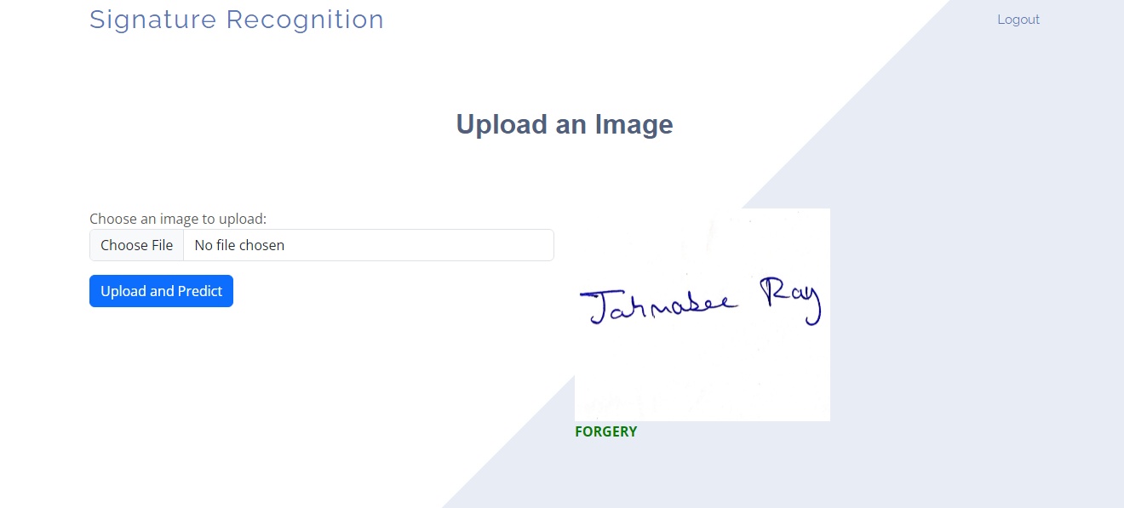
Output page

Slide 55
CONCLUSION
This project combines CNN and MobileNet for efficient handwritten signature classification, tackling challenges like computational efficiency and generalization. Through preprocessing, CNN-based feature extraction, and MobileNet classification, it achieves promising results. Transfer learning and data augmentation enhance robustness. With fast inference, it suits real-time applications on various devices. Its modular design allows for future enhancements. This solution bridges accuracy and efficiency, vital for security in digital transactions and identity verification.

Slide 56
FUTURE ENHANCEMENT
Future enhancements for the proposed handwritten signature classification system will focus on accuracy, efficiency, and usability. Advanced deep learning models like MobileNetV3 or EfficientNet will be explored for better performance. Advanced data augmentation methods will introduce realistic modifications for increased robustness. Adversarial training will enhance resilience against attacks, improving security. Transfer learning will be optimized through pre-trained models and fine-tuning strategies for better accuracy with less training data. These advancements aim to maintain the system's cutting-edge status in identity verification across various real-world applications.

Slide 57
REFERENCES
Impedovo, D., & Pirlo, G. (2008). Automatic Signature Verification: The State of the Art. IEEE Transactions on Systems, Man, and Cybernetics, Part C (Applications and Reviews), 38(5), 609–635.
Plamondon, R., & Lorette, G. (1989). Automatic signature verification and writer identification — the state of the art. Pattern Recognition, 22(2), 107-131.
Hafemann, L. G., Sabourin, R., & Oliveira, L. S. (2017). Learning features for offline handwritten signature verification using deep convolutional neural networks. In Proceedings of the International Conference on Image Processing Theory, Tools and Applications (IPTA).
Fierrez, J., Ortega-Garcia, J., Ramos, D., & Gonzalez-Rodriguez, J. (2007). HMM-based on-line signature verification: Feature extraction and signature modeling. In Proceedings of the 17th International Conference on Pattern Recognition (ICPR).

Slide 58
REFERENCES
Rivard, D., Plamondon, R., & Kaltenbach, M. (1992). A comparative analysis of signature verification algorithms. Pattern Recognition, 25(3), 291–307.
Kholmatov, A., & Yanikoglu, B. (2005). Identity authentication using improved online signature verification method. Pattern Recognition Letters, 26(15), 2400-2408.
LeCun, Y., Bengio, Y., & Hinton, G. (2015). Deep learning. Nature, 521(7553), 436-444.

